Slide 1
Modeling of high-strength steels (HSS) in automobile forming (DP1000)
Group 5: An Mai, Thoa Le, Hoang Le, Linh Nguyen
Advisor: Li Zinan
Supervisor: Junhe Lian
Aalto University, Finland
Notes:
high strength and hierarchical bcc microstructure

Slide 2
Table of Contents
Introduction
Methodology
Brief recap of working flow and recap
Constitutive model
Temperature calibration
Strain-rate calibration
Machine learning
Methodology
Validation
Constitutive model
Machine learning model
Discussion and conclusion
Comparison between constitutive model and machine learning model
Results summary

Slide 3
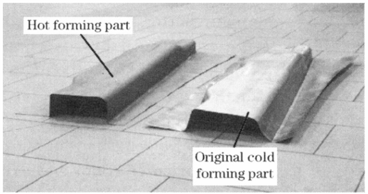
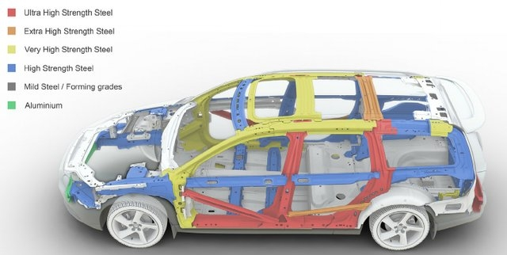
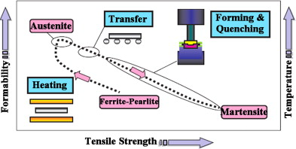
Introduction
Picture of hot forming and cold forming vehicle parts. Chang, Meng, et al, 2011
* Advanced steel applications in a modern car body structure. Asghari et al, MSEA 2013.
An overview of the hot stamping process sequence. Naderi et al, 2011

Slide 4
Table of Contents
Introduction Motivation --An
Methodology --An
Brief recap of working flow
Recap first half progress: Constitutive + ML
Constitutive model
Temperature calibration: How + results --Thoa
Strain-rate calibration: How + result --Linh
Validation --An
Machine learning --Hoang
How + results
Validation: 500C with simulation
Discussion + Conclusion
Summary of final results + compare with the existing paper -- Thoa
Comparison -- Linh
Conclusion: Lesson learnt

Slide 5

Methodology
ML-coupled model
2
StrRtDpn & TmpDpn params calibration
Uniaxial tensile test
Abaqus simulation
6
3
4
5
6
1
Flow fitting curve
Fracture test

Slide 6
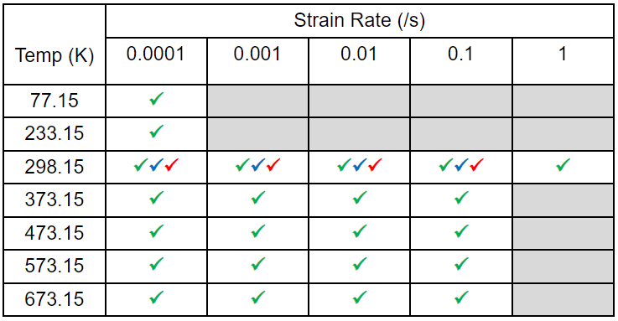
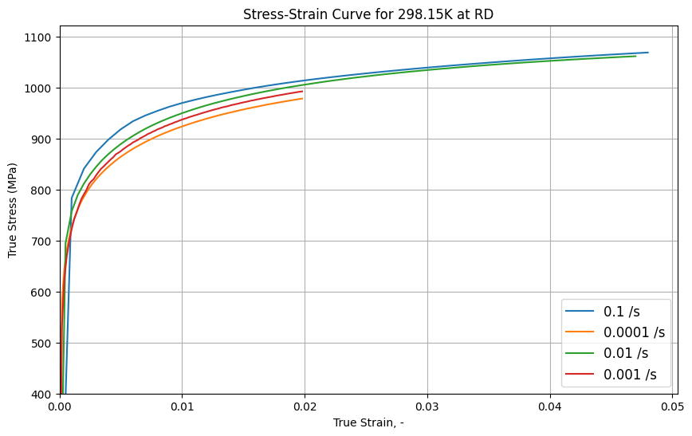
Recap of first half progress
Uniaxial tensile tests 43 cases on DP1000 (DD,RD,TD,Tmpt, StrnRt)

Slide 7
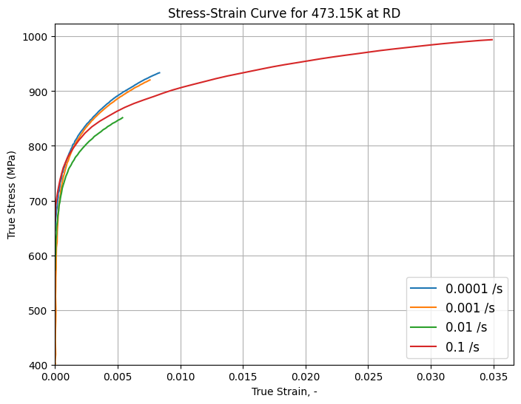
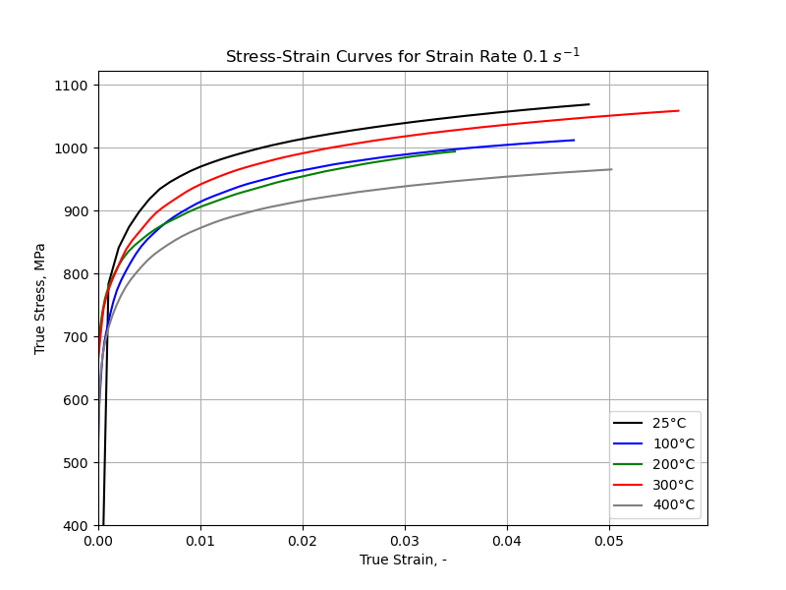
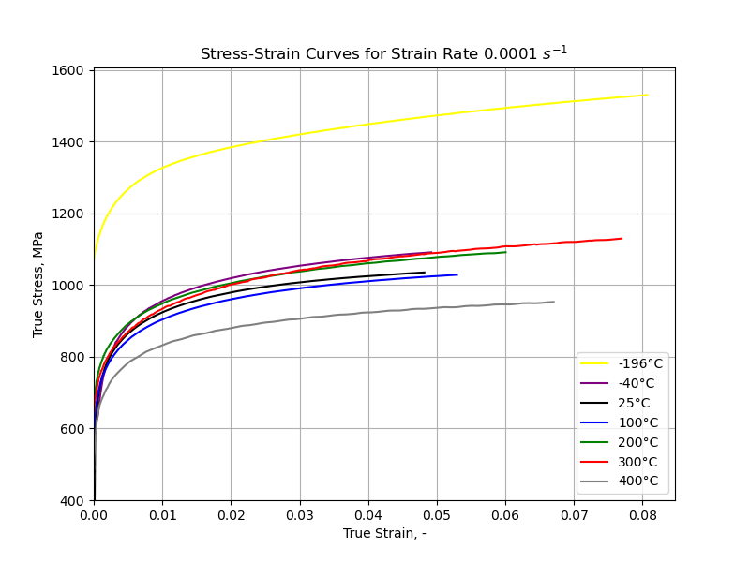
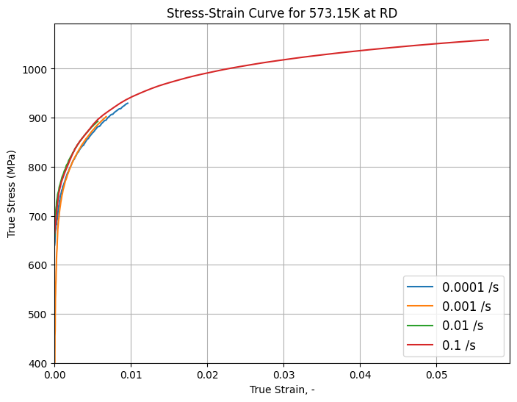
Recap of first half progress
Uniaxial tensile tests:
What has been done:
Process data
Graph strain-rate dependent and temperature dependent flow curves

Slide 8
Recap of first half progress
ML-coupled model
2
StrRtDpn & TmpDpn params calibration
Uniaxial tensile test
Abaqus simulation
6
3
4
5
6
1
Flow fitting curve
Fracture test

Slide 9
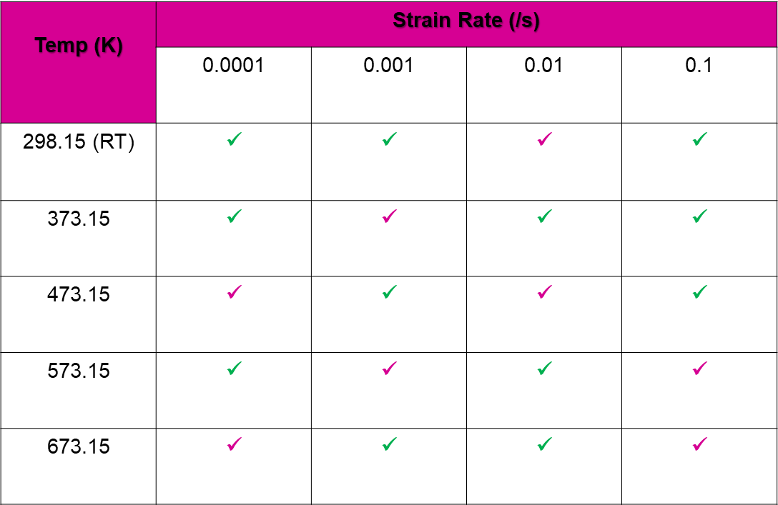
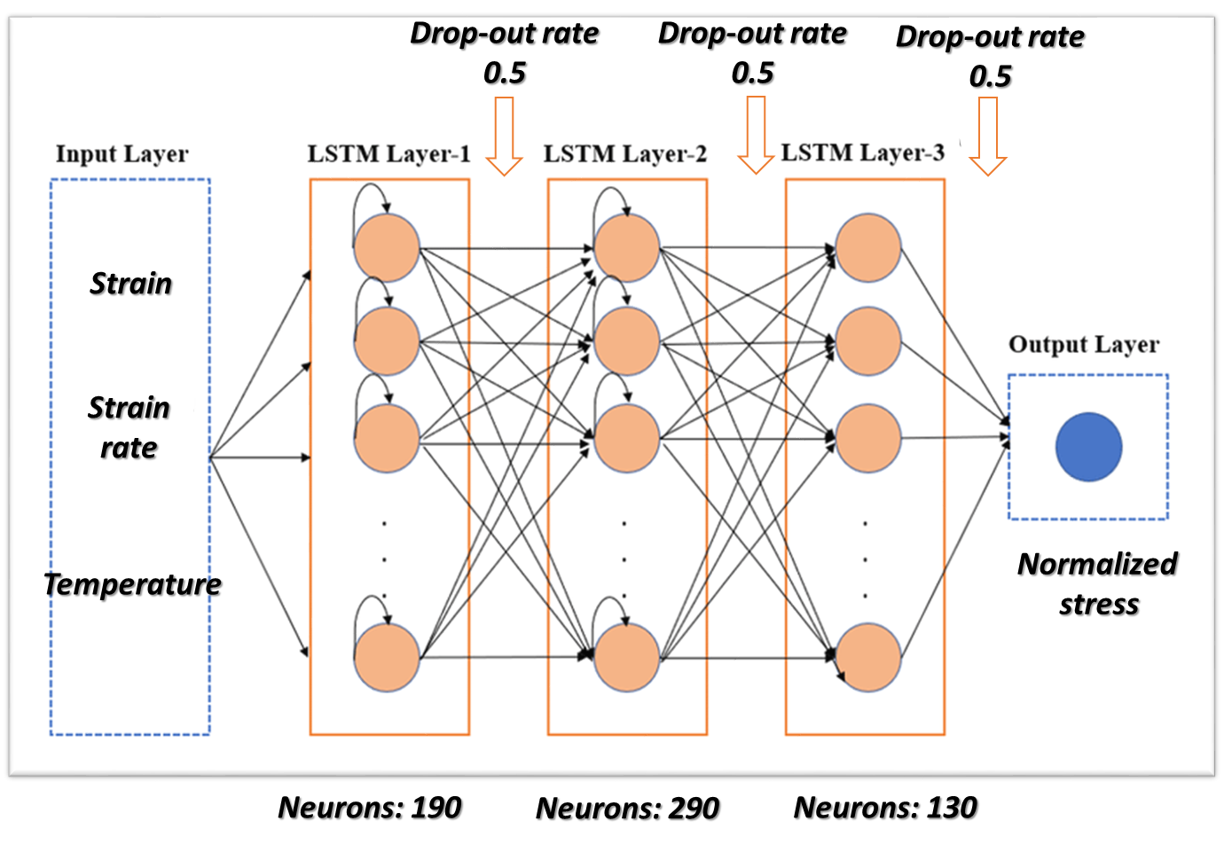

Recap of first half progress
ML-coupled for temperature and strain-rate dependence
What has been done:
Built an LSTM Machine Learning model.
Used 8 flow curves for training, 12 for testing

Slide 10
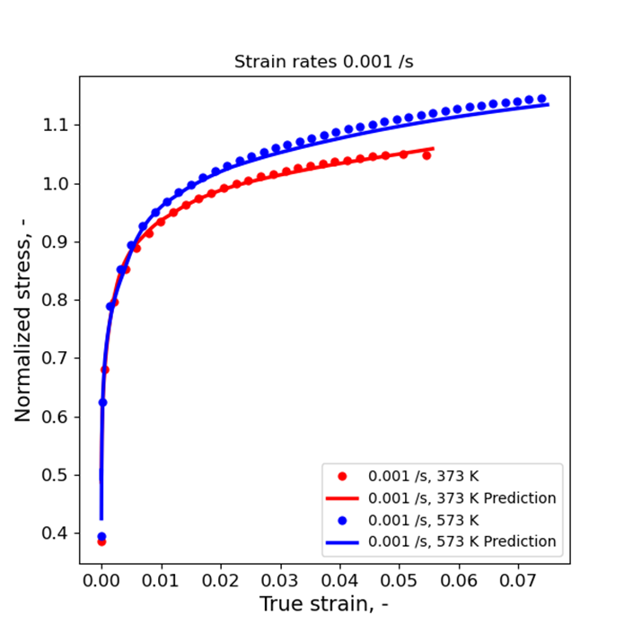
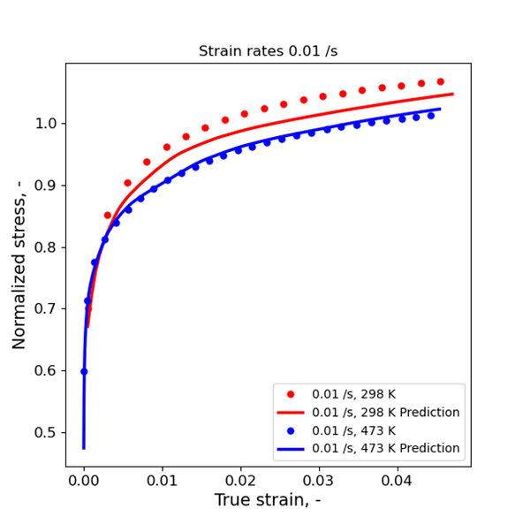
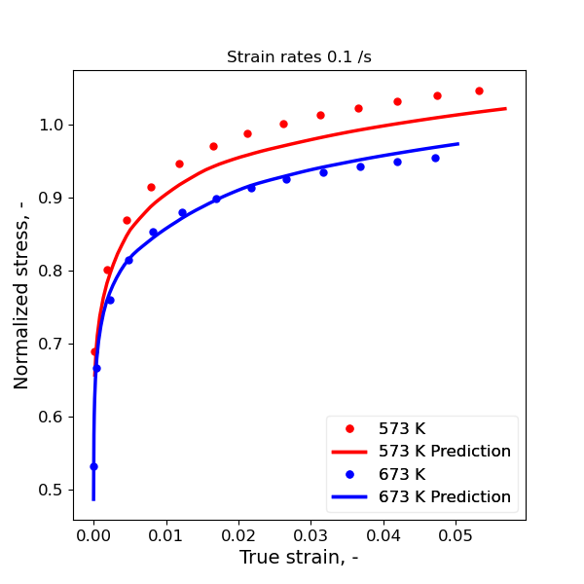
Recap of first half progress
ML-coupled for temperature and strain-rate dependence
What has been done:
Built an LSTM Machine Learning model.
Used 8 flow curves for training, 12 for testing
Training results: R-squared > 0.985

Slide 11
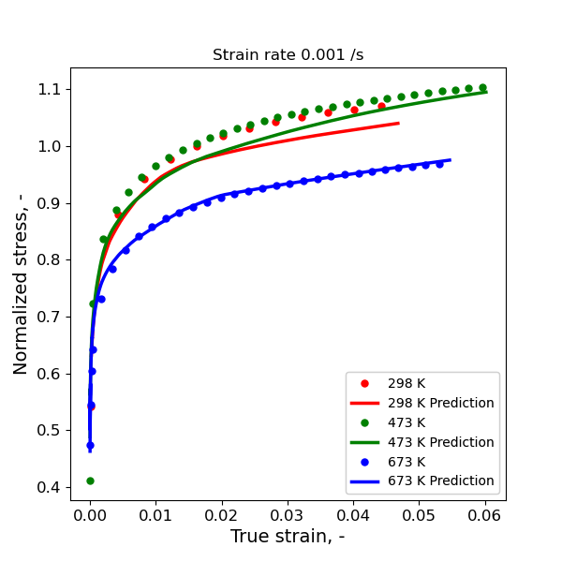
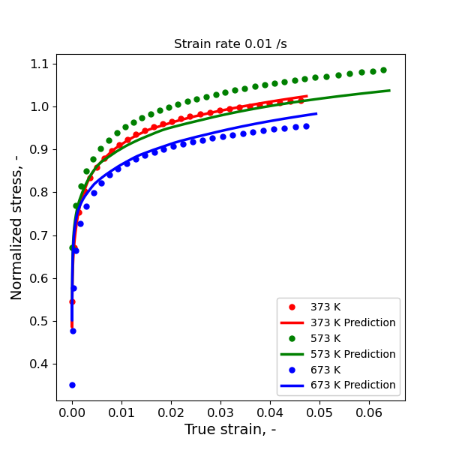
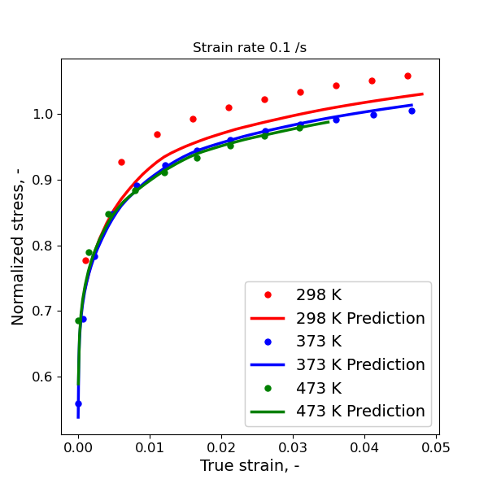
Recap of first half progress
ML-coupled for temperature and strain-rate dependence
What has been done:
Built an LSTM Machine Learning model.
Used 8 flow curves for training, 12 for testing
Training results: R-squared > 0.985
Testing results are not are not good

Slide 12
Recap of first half progress
ML-coupled model
2
StrRtDpn & TmpDpn params calibration
Uniaxial tensile test
Abaqus simulation
6
3
4
5
6
1
Flow fitting curve
Fracture test

Slide 13
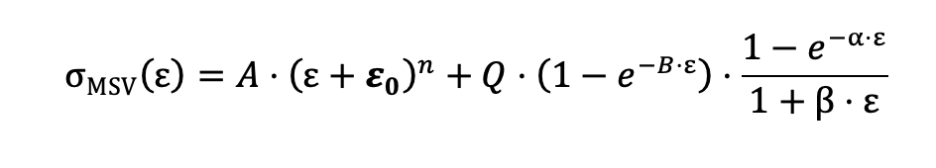
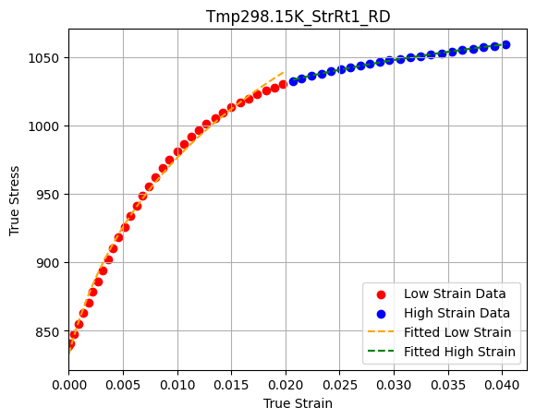
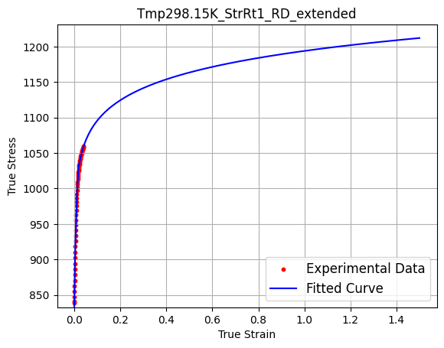
Recap of first half progress
Flow fitting curve
What has been done?
Extend experimental data until strain value of 3
Use curve_fit() function to find parameters for S-V equation for lower strain rates, and modify S-V equation at higher strain rates

Slide 14
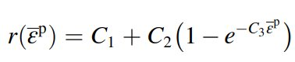
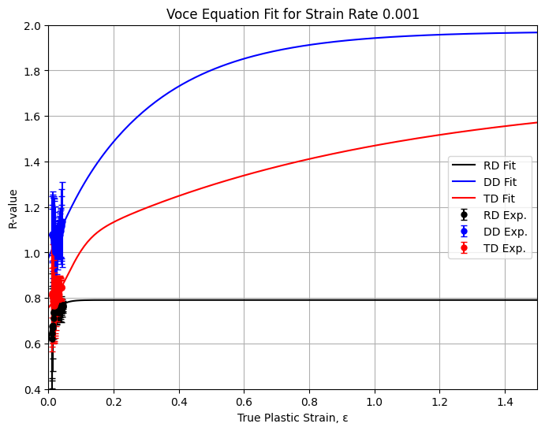
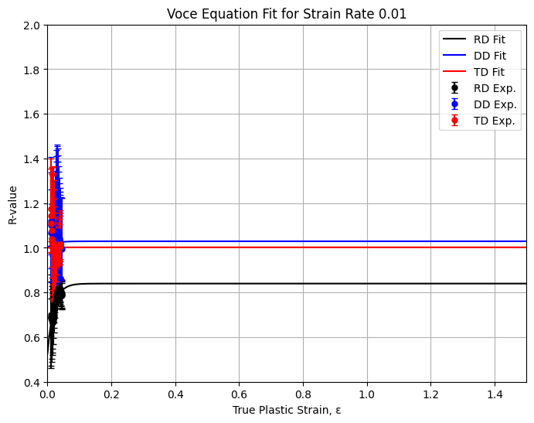
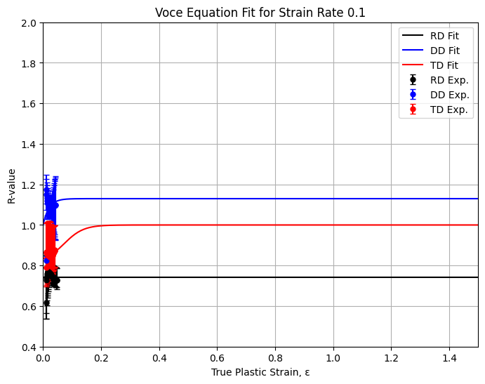
Recap of first half progress
Flow fitting curve
What has been done?
Extend experimental data until strain value of 3
Use curve_fit() function to find parameters for S-V equation for lower strain rates, and modify S-V equation at higher strain rates
Use curve_fit() for the r-value fitting

Slide 15
Recap of first half progress
ML-coupled model
2
StrRtDpn & TmpDpn params calibration
Uniaxial tensile test
Abaqus simulation
6
3
4
5
6
1
Flow fitting curve
Fracture test

Slide 16
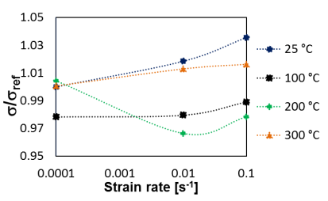
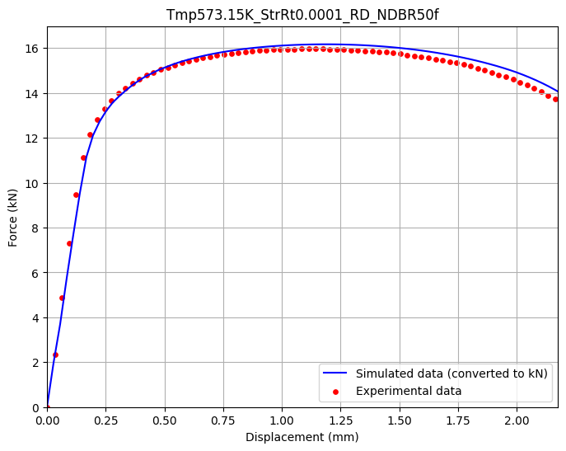
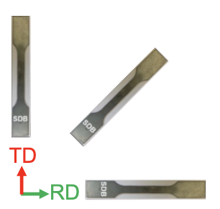
Methodology
4. Abaqus simulation
DP material properties including strain, stress in RD,TD,DD, biaxial direction, r-values (Lankford coefficients).
Loading direction for 5 geometries
VUMAT subroutine
5. Fracture tests – Force and Displacement curve
Reference
Reference

Slide 17
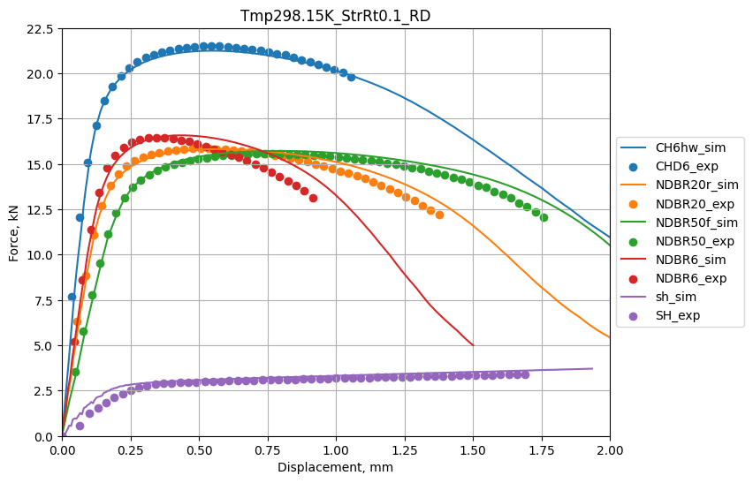
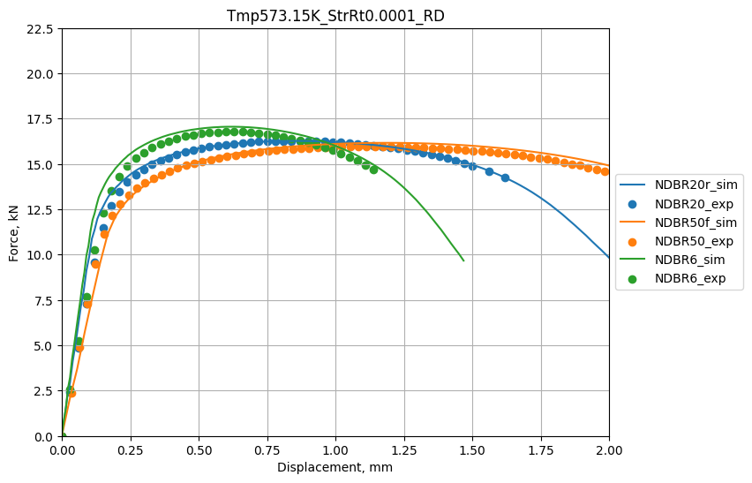
Recap of first half progress
What has been done?
Use data of flow curves along 0, 45, 90, biaxial and r-values along 3 loading direction to make material input files.
Run Abaqus simulation: 305 cases.
Run ODB files through Abaqus CAE to obtain force-displacement data
Plot simulated data and experimental data to validate

Slide 18
Current objectives
ML-coupled model
2
2
StrRtDpn & TmpDpn params calibration
Uniaxial tensile test
Abaqus simulation
6
3
4
5
6
1
Flow fitting curve
Fracture test
5
6
1
3
4
Flow fitting curve
Fracture test

Slide 19
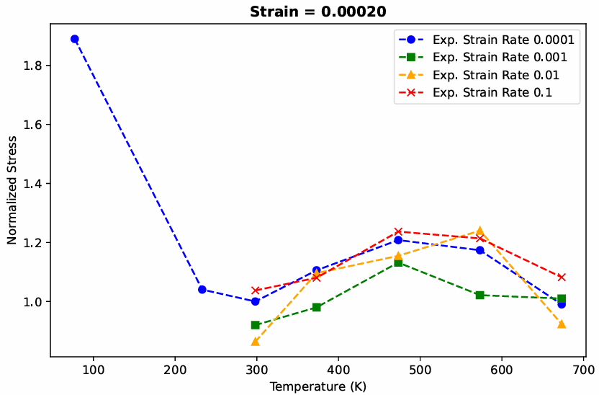
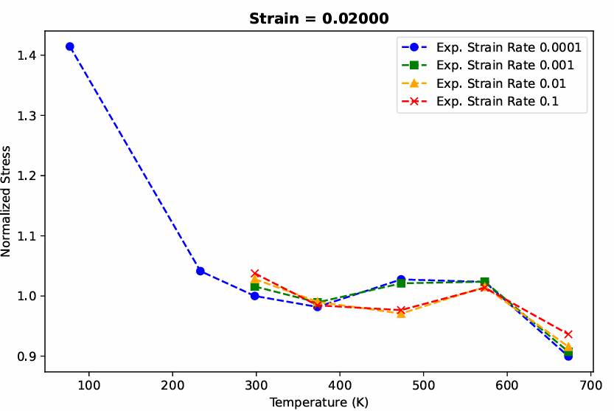
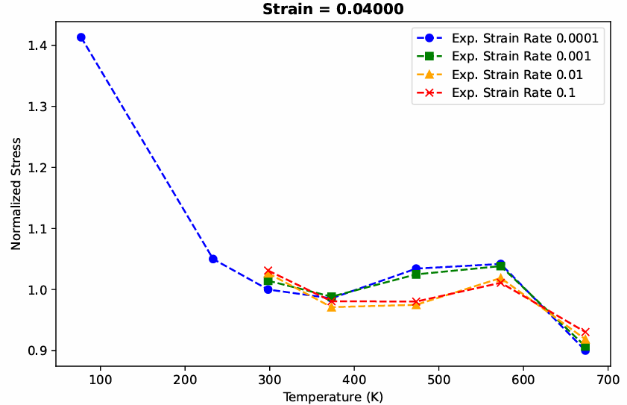

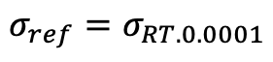
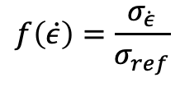
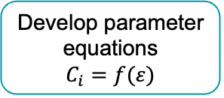
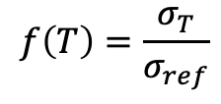
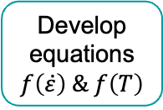
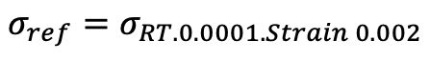
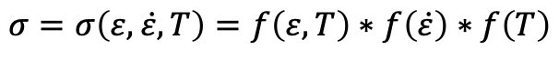
Constitutive model – Introduction
Stress function
Strain effect
Temperature effect
Strain-rate effect
Thermal softening
Dynamic strain aging
Adiabatic heat
Reference stress
$$σ=σ\left(ε,\dot{ε},T\right)=f\left(ε,T\right)∗f\left(\dot{ε}\right)∗f\left(T\right)$$
$$f\left(\dot{ε}\right)=\frac{σ_{\dot{ε}}}{σ_{ref}}$$
$$f\left(T\right)=\frac{σ_{T}}{σ_{ref}}$$
Study temperature / strain-rate and stress relationship
Define reference stress
Develop equations
$$f\left(\dot{ε}\right) \& f\left(T\right)$$
Develop parameter equations
$$C_{i}=f(ε)$$
Fixed stress
$$σ_{ref}=σ_{RT.0.0001.Strain 0.002}$$
Simulation validation
Fitting validation
Flow stress
$$σ_{ref}=σ_{RT.0.0001}$$

Slide 20
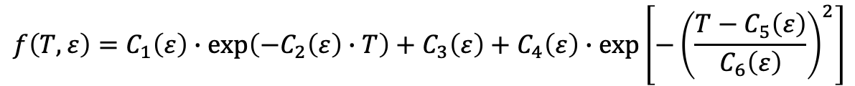
Constitutive model – Temperature parameters calibration
Given 6-parameter equation
F. Shen, et al.2020,Int. J. Plasy.
$$f\left(T,ε\right)=C_{1}\left(ε\right)∙\exp\left(−C_{2}\left(ε\right)∙T\right)+C_{3}\left(ε\right)+C_{4}\left(ε\right)∙\exp\left[−{\left(\frac{T−C_{5}\left(ε\right)}{C_{6}\left(ε\right)}\right)}^{2}\right]$$
Thermal Softening Dynamic Strain Aging
Less accurate at some strains
Depends significantly on initial guesses, and extensive iterations were required to achieve satisfactory results
Proposed 9-parameter equation
$$f\left(T,ε\right)=C_{1}\left(ε\right)∙\exp\left(−C_{2}\left(ε\right)∙T\right)+C_{3}\left(ε\right)+C_{4}\left(ε\right)∙\exp\left[−{\left(\frac{T−C_{5}\left(ε\right)}{C_{6}\left(ε\right)}\right)}^{2}\right]+C_{7}\left(ε\right)∙\exp\left[−{\left(\frac{T−C_{8}\left(ε\right)}{C_{9}\left(ε\right)}\right)}^{2}\right]$$
Thermal Softening Dynamic Strain Aging
More complicated
More accurate
Less dependent on initial guesses

Slide 21
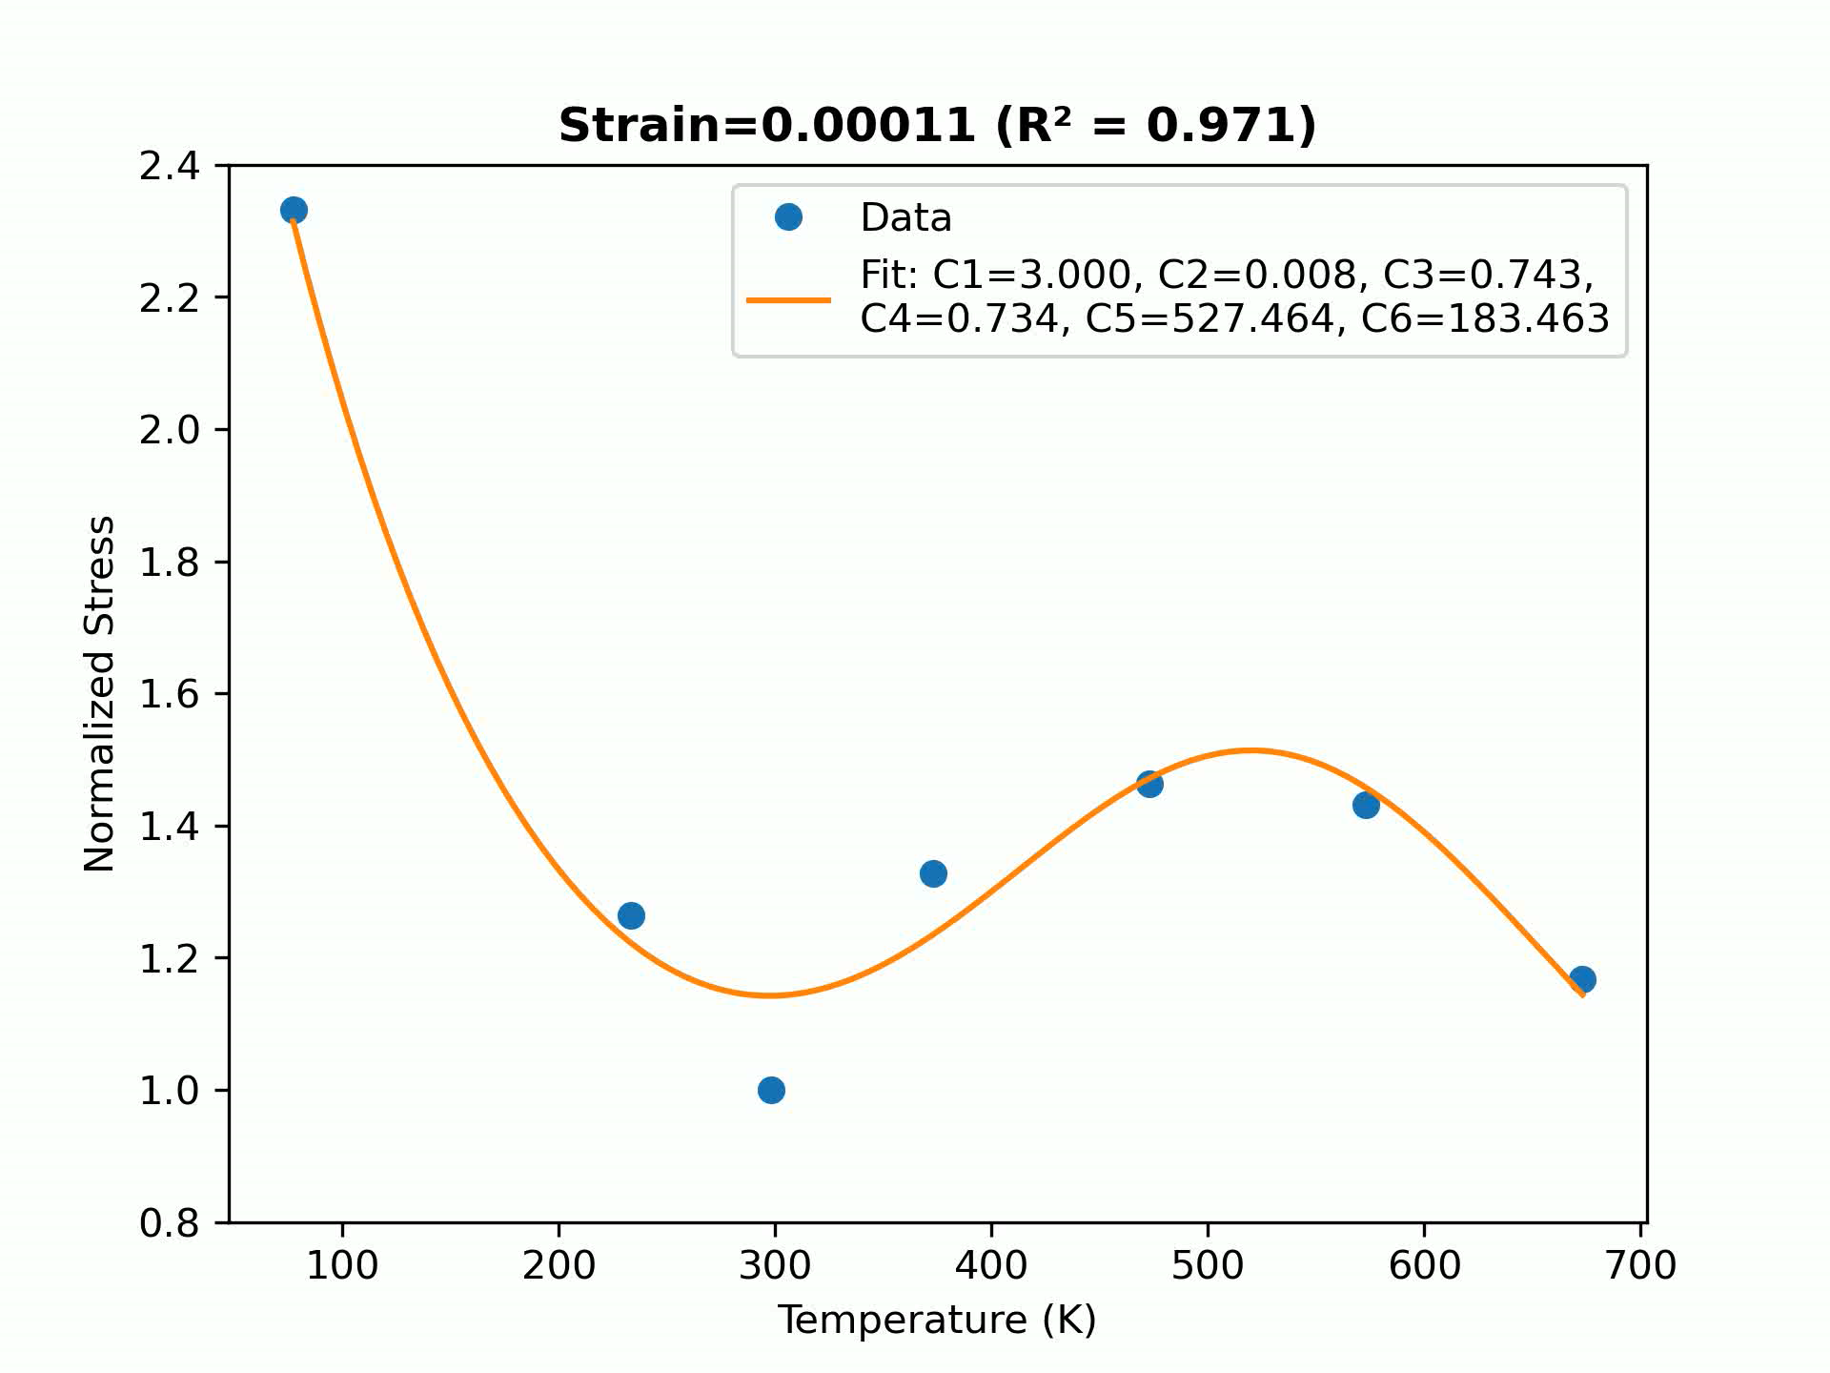
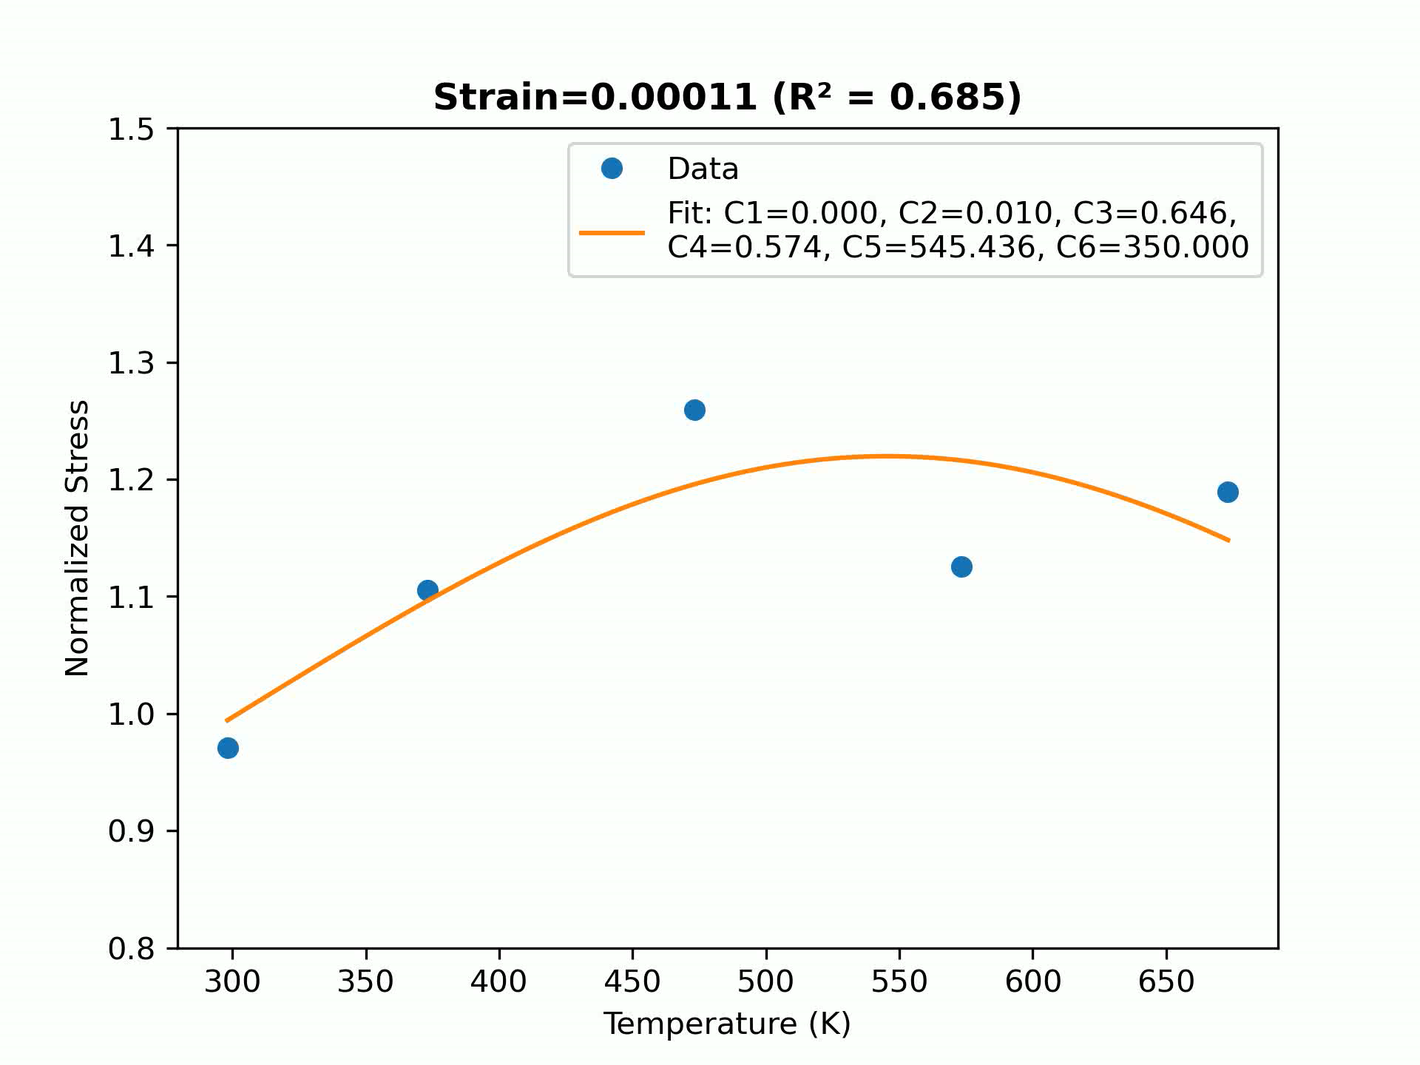
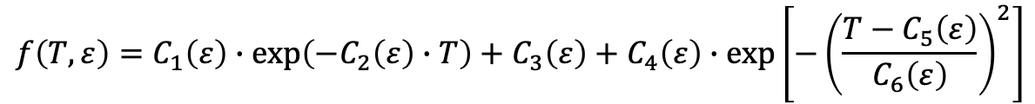
Constitutive model – Temperature parameters calibration
Given 6-parameter equation
$$f\left(T,ε\right)=C_{1}\left(ε\right)∙\exp\left(−C_{2}\left(ε\right)∙T\right)+C_{3}\left(ε\right)+C_{4}\left(ε\right)∙\exp\left[−{\left(\frac{T−C_{5}\left(ε\right)}{C_{6}\left(ε\right)}\right)}^{2}\right]$$
F. Shen, et al.2020,Int. J. Plasy.
Strain-rate 0.0001
Strain-rate 0.001
Smallest R-squared value: 0.971
Largest R-squared value: 1
Average value: 0.994
R-squared values > 0.99: 99.75%
Smallest R-squared value: 0.685
Largest R-squared value: 1
Average value: 0.998
R-squared values > 0.99: 98.48%

Slide 22
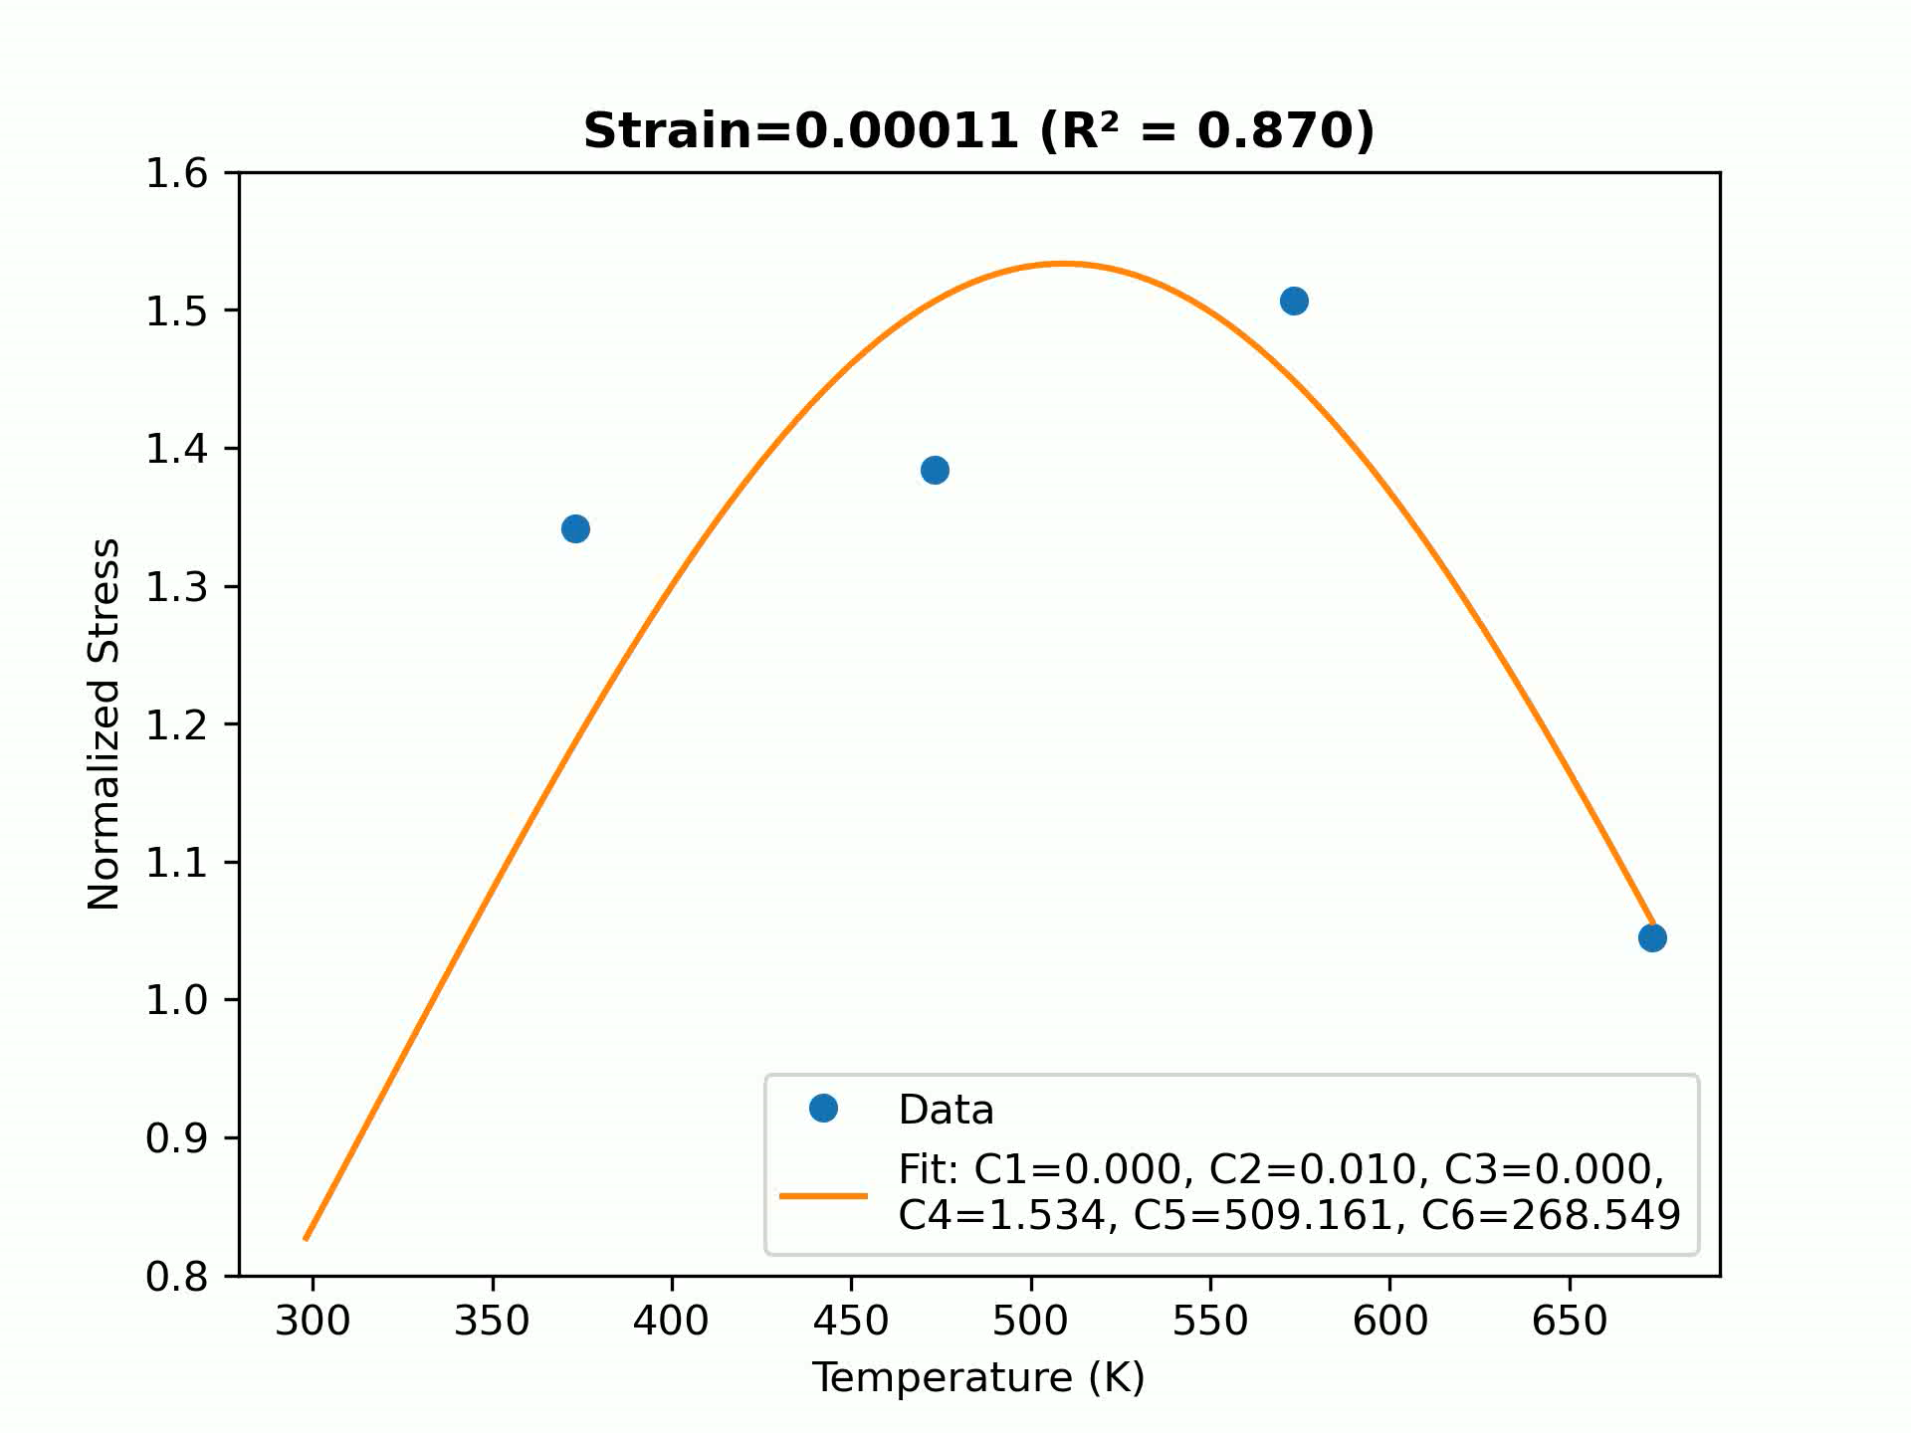
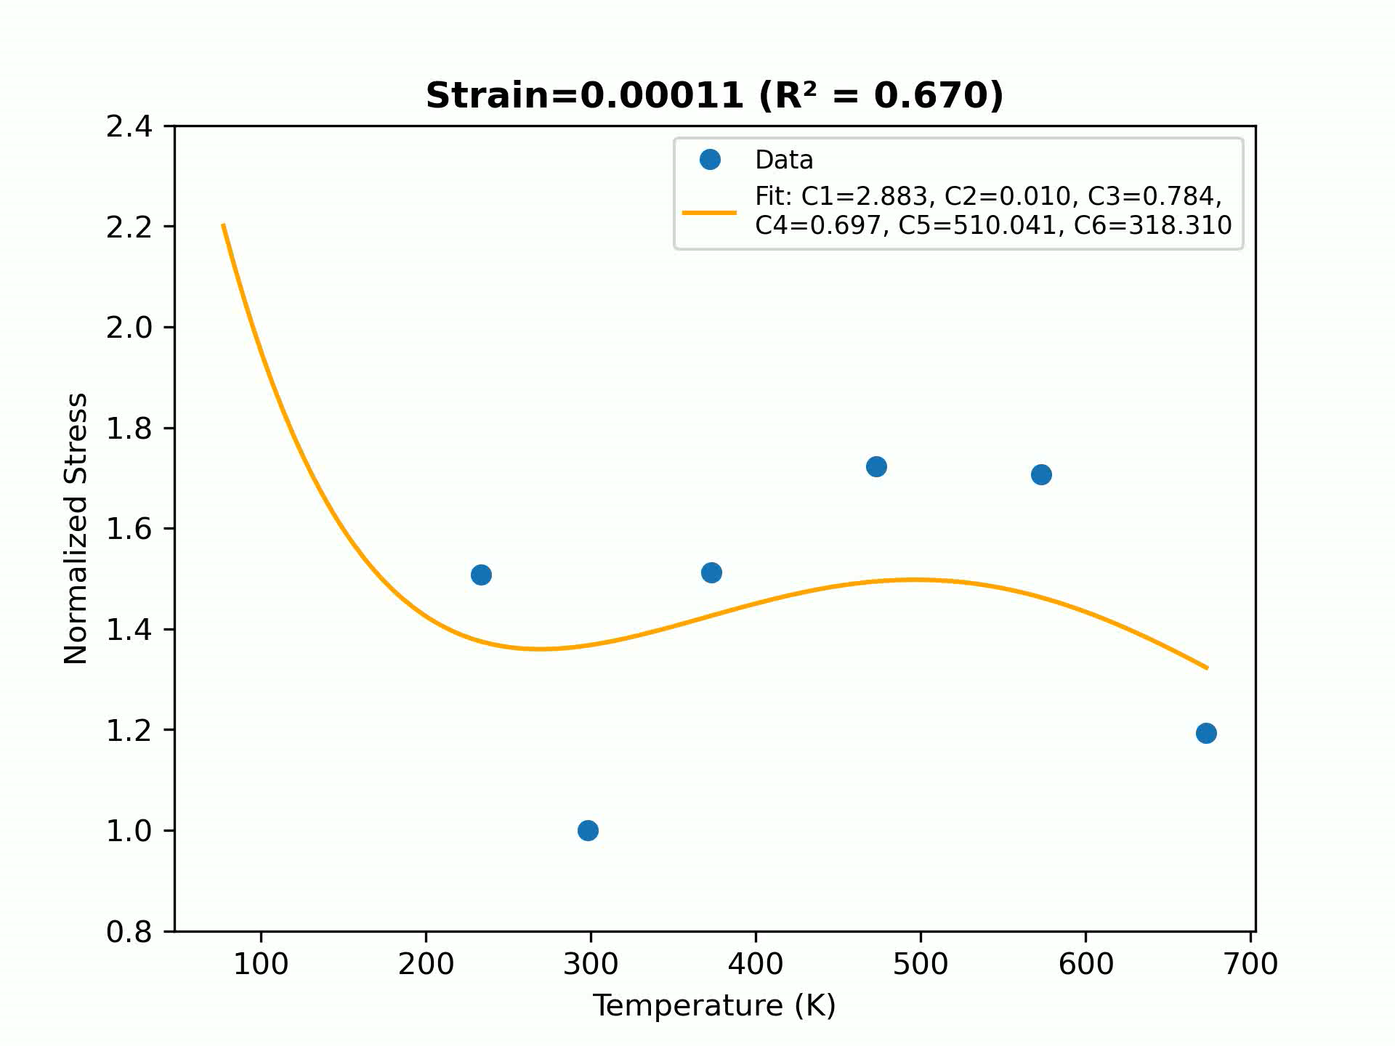
Constitutive model – Temperature parameters calibration
Given 6-parameter equation
$$f\left(T,ε\right)=C_{1}\left(ε\right)∙\exp\left(−C_{2}\left(ε\right)∙T\right)+C_{3}\left(ε\right)+C_{4}\left(ε\right)∙\exp\left[−{\left(\frac{T−C_{5}\left(ε\right)}{C_{6}\left(ε\right)}\right)}^{2}\right]$$
F. Shen, et al.2020,Int. J. Plasy.
Strain-rate 0.01
Strain-rate 0.1
Smallest R-square value: 0.87
Largest R-square value: 1
Average value: 0.996
R-square values > 0.99: 84.81%
Smallest R-square value: 0.449
Largest R-square value: 1
Average value: 0.987
R-square values > 0.99: 94.94%

Slide 23
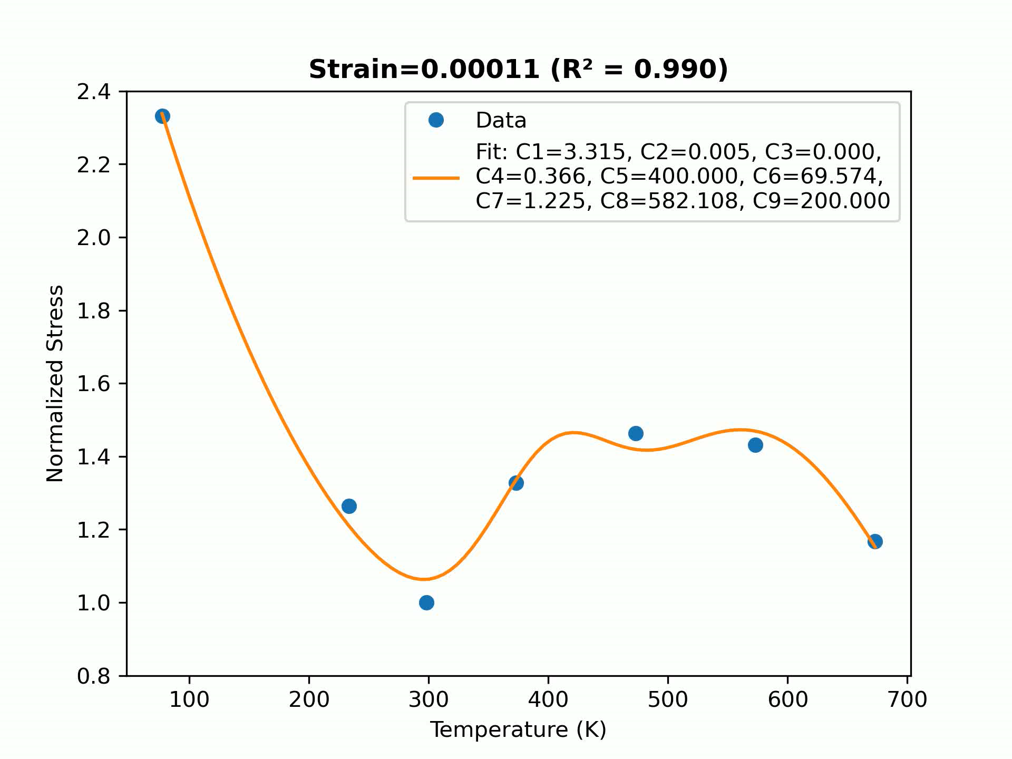
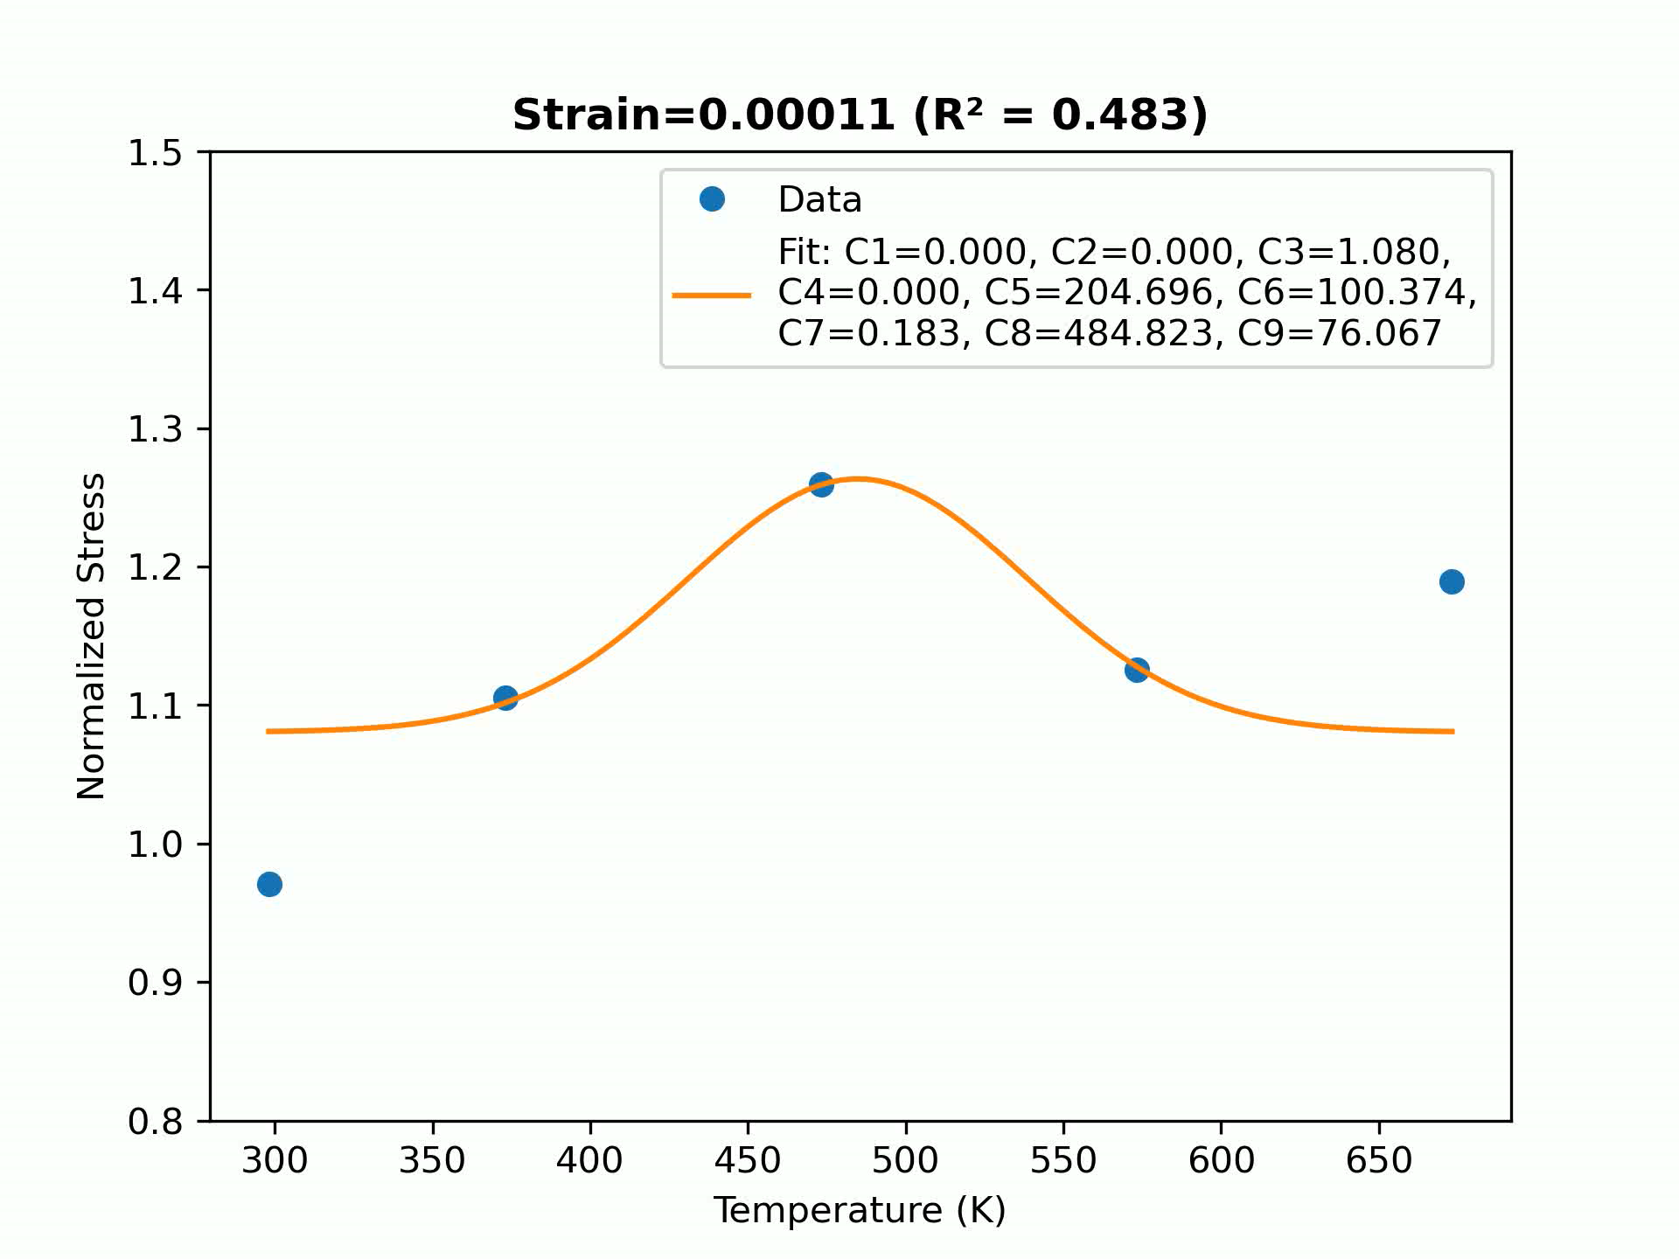
Constitutive model – Temperature parameters calibration
Proposed 9-parameter equation
$$f\left(T,ε\right)=C_{1}\left(ε\right)∙\exp\left(−C_{2}\left(ε\right)∙T\right)+C_{3}\left(ε\right)+C_{4}\left(ε\right)∙\exp\left[−{\left(\frac{T−C_{5}\left(ε\right)}{C_{6}\left(ε\right)}\right)}^{2}\right]+C_{7}\left(ε\right)∙\exp\left[−{\left(\frac{T−C_{8}\left(ε\right)}{C_{9}\left(ε\right)}\right)}^{2}\right]$$
Strain-rate 0.0001
Strain-rate 0.001
Smallest R-squared value: 0.99
Largest R-squared value: 1
Average value: 1
R-squared values > 0.99: 100%
Smallest R-squared value: 0.483
Largest R-squared value: 1
Average value: 0.998
R-squared values > 0.99: 99.24%

Slide 24
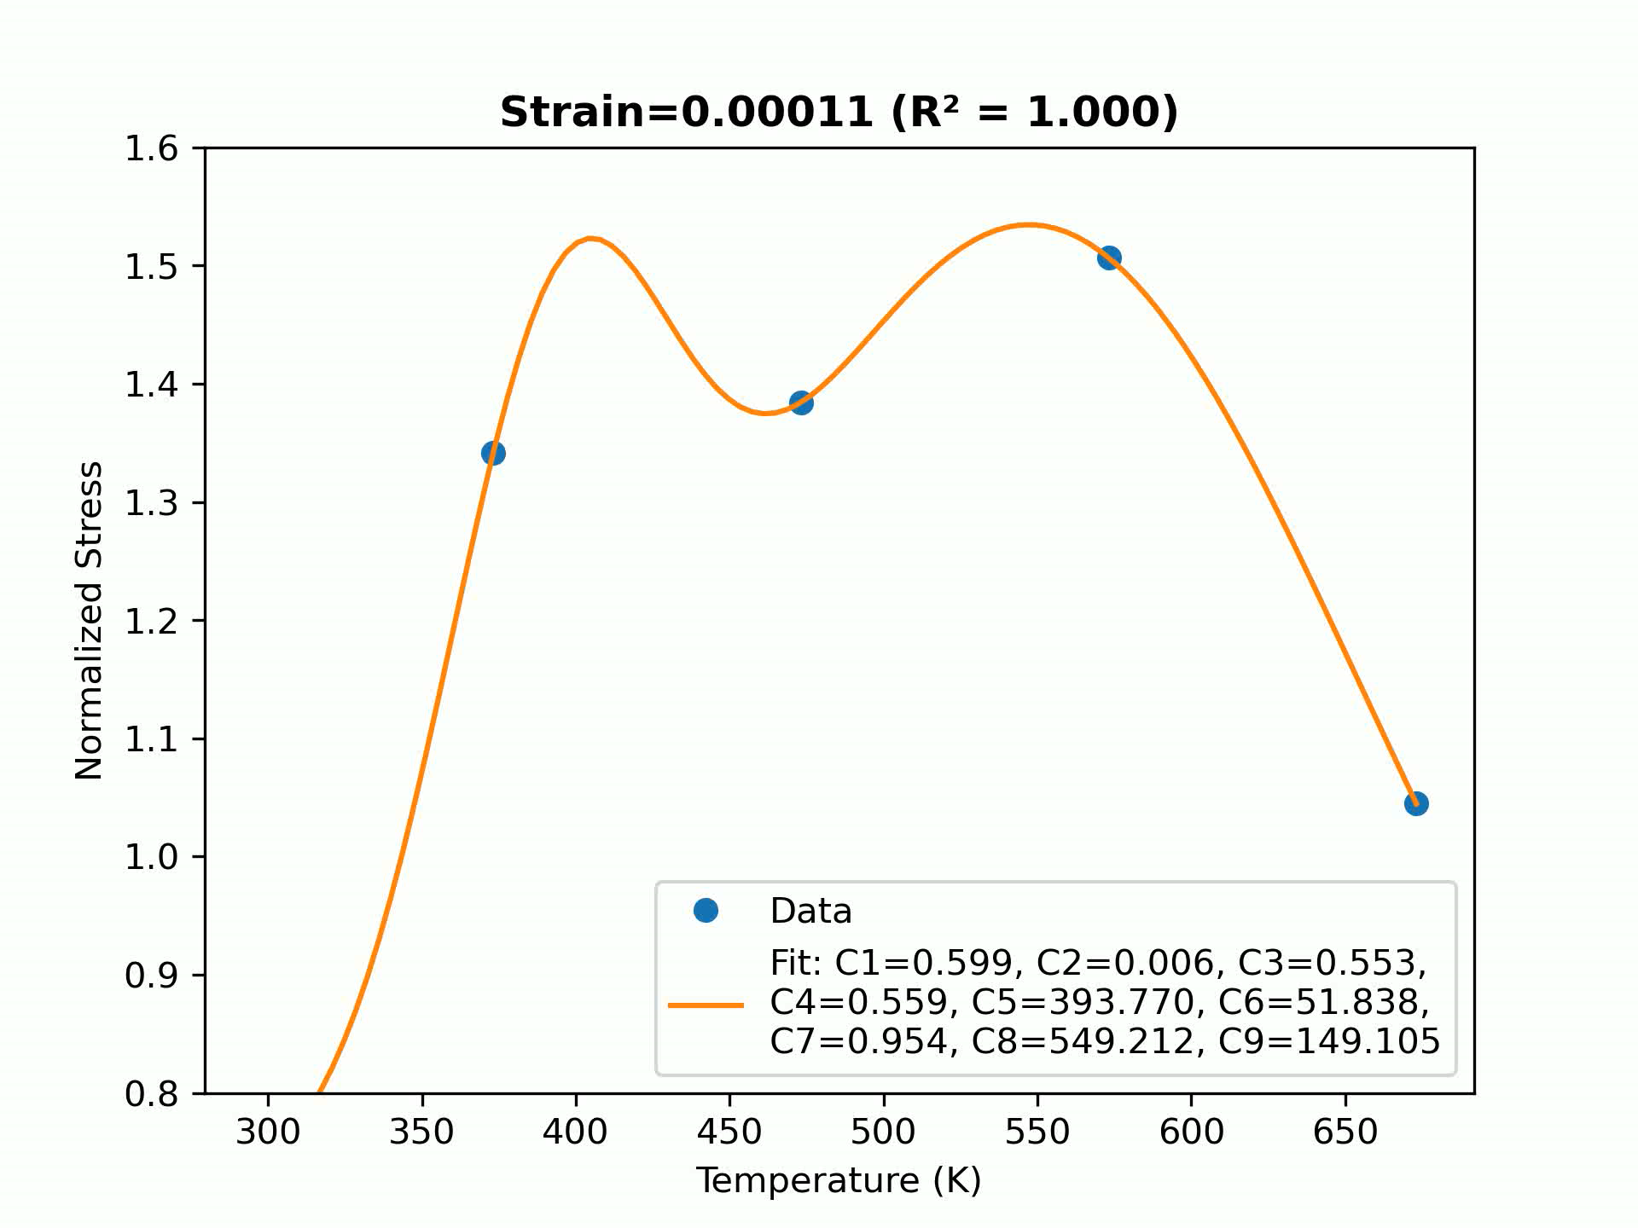
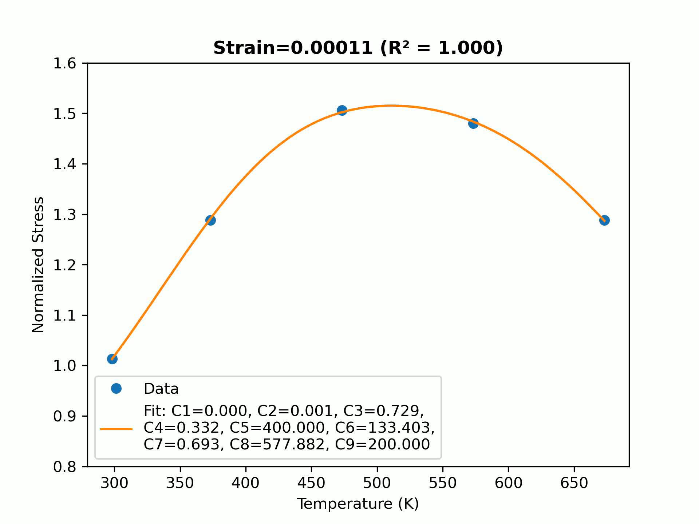
Constitutive model – Temperature parameters calibration
Proposed 9-parameter equation
$$f\left(T,ε\right)=C_{1}\left(ε\right)∙\exp\left(−C_{2}\left(ε\right)∙T\right)+C_{3}\left(ε\right)+C_{4}\left(ε\right)∙\exp\left[−{\left(\frac{T−C_{5}\left(ε\right)}{C_{6}\left(ε\right)}\right)}^{2}\right]+C_{7}\left(ε\right)∙\exp\left[−{\left(\frac{T−C_{8}\left(ε\right)}{C_{9}\left(ε\right)}\right)}^{2}\right]$$
Strain-rate 0.01
Strain-rate 0.1
Smallest R-squared value: 0.975
Largest R-squared value: 1
Average value: 0.999
R-squared values > 0.99: 97.47%
Smallest R-squared value: 0.91
Largest R-squared value: 1
Average value: 1
R-squared values > 0.99: 99.75%

Slide 25
Constitutive model – Temperature parameters calibration
Proposed equation vs given equations $f\left(T,ε\right)$
R-squared | Strain-rate 0.0001 |  | Strain-rate 0.001 |  | Strain-rate 0.01 |  | Strain-rate 0.1
Function | 6-parameter | 9-parameter | 6-parameter | 9-parameter | 6-parameter | 9-parameter | 6-parameter | 9-parameter
Smallest value | 0.971 | 0.99 | 0.685 | 0.483 | 0.87 | 0.975 | 0.449 | 0.91
Largest value | 1 | 1 | 1 | 1 | 1 | 1 | 1 | 1
Average value | 0.994 | 1 | 0.998 | 0.998 | 0.996 | 0.999 | 0.987 | 1
R-squared values > 0.99 | 99.75% | 100% | 98.48% | 99.24% | 84.81% | 97.47% | 94.94% | 99.75%
The 9-parameter function provides higher accuracy and greater consistency.

Slide 26
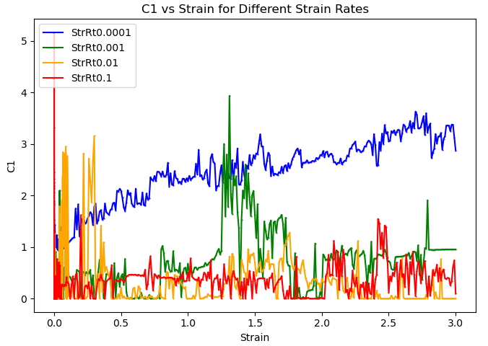


Constitutive model – Temperature parameters calibration
Parameter calibration
$$C_{i}=f\left(ε\right)$$
One function for all parameters
Proposed 9-parameter equation
Given 6-parameter equation
The trend varies significantly across different strain rates
It is manageable to calibrate parameters for strain rate 0.0001
Continue to calibrate C parameter
=> Parameters evolving with strain

Slide 27



Constitutive model – Temperature parameters calibration
Thermal parameters C1 – C6 calibration (for Strain rate 0.0001)
C1
C2
C3
$$C_{i}=f\left(ε\right)=Q_{1}∙\exp\left(−\frac{{\left(ε−Q_{2}\right)}^{2}}{2∙Q_{3}^{2}}\right)+P_{1} ∙\exp\left(−P_{2}∙ε\right)+M_{1}∙\exp\left(−\frac{{\left(ε−M_{2}\right)}^{2}}{2∙M_{3}^{2}}\right)+\frac{N_{1}}{1+\exp{(−N_{2}∙\left(ε−M_{2}\right))}}$$
Low strain: Initial rapid changes (first Gaussian and decay).
Intermediate strain: Subsequent rises and peaks (second Gaussian).
Large strain: Final stabilization or leveling off (logistic function).

Slide 28



Constitutive model – Temperature parameters calibration
Thermal parameters C1 – C6 calibration (for Strain rate 0.0001)
C4
C5
C6
 | C1 | C2 | C3 | C4 | C5 | C6
R-squared value | 0.998 | 0.996 | 0.99 | 0.974 | 0.996 | 0.915

Slide 29

Constitutive model – Temperature parameters calibration
Stress validation result
$$C_{i}=f\left(ε\right)=Q_{1}∙\exp\left(−\frac{{\left(ε−Q_{2}\right)}^{2}}{2∙Q_{3}^{2}}\right)+P_{1} ∙\exp\left(−P_{2}∙ε\right)+M_{1}∙\exp\left(−\frac{{\left(ε−M_{2}\right)}^{2}}{2∙M_{3}^{2}}\right)+\frac{N_{1}}{1+\exp{(−N_{2}∙\left(ε−M_{2}\right))}}$$
$$f\left(T,ε\right)=C_{1}\left(ε\right)∙\exp\left(−C_{2}\left(ε\right)∙T\right)+C_{3}\left(ε\right)+C_{4}\left(ε\right)∙\exp\left[−{\left(\frac{T−C_{5}\left(ε\right)}{C_{6}\left(ε\right)}\right)}^{2}\right]$$
Average R-squared value: 0.973
R-squared values > 0.9: 96.46%
From strain 0.012, fitting quality is improved
The model is validated

Slide 30






Constitutive model – strain-rate dependent parameters calibration
Stress function
Strategy
Develop equations
$$f\left(\dot{ε}\right) \& f\left(T\right)$$
Develop parameter equations
$$C_{i}=f(ε)$$
Study temperature / strain-rate and stress relationship
Define reference stress
Simulation validation
Fitting validation
Flow stress
$$σ_{\text{ref}}=\frac{σ_{\dot{ϵ}}}{σ_{\text{RT}\text{, }\text{QS}}}$$

Slide 31


Constitutive model – strain-rate dependent parameters calibration
Experimental data
Strain-rate dependency varies greatly between temperatures.
Temperature affects thermal activation, deformation mechanisms and microstructural evolution.
Notes:
Thermal Activation: Higher temperatures enhance atomic motion, reducing resistance to deformation and increasing strain-rate sensitivity.
Deformation Mechanisms: Dominant mechanisms (e.g., dislocation glide, creep) vary with temperature, altering stress-strain behavior.
Microstructural Evolution: Temperature impacts grain structure, phase transformations, and recovery processes, driving differences in strain-rate dependency.
-

Slide 32



Constitutive model – strain-rate dependent parameters calibration
Given equations
Power-law (Kleemola, H.J. and Ranta-Eskola, A.J., 1979)
Wagoner (Wagoner, R.H., 1981)
Past student’s proposal
=> Assume simple linear or logarithmic relationship between normalized stress and strain
Notes:
Power-law and Wagoner: If your data shows a more complex stress-strain rate behavior (e.g., non-linear trends, asymptotes, or transitions at extreme strain rates), these models cannot accommodate such behaviors. This is because they rely solely on simple mathematical forms (power-law and square-root terms) and lack terms like quadratic or logarithmic contributions.
Student: Assume that the relationship between stress and strain rate (after normalization) is nearly linear or a simple logarithmic function. If the data shows deviations or bending patterns that cannot be captured by a linear-log or power-law model.

Slide 33



Constitutive model – strain-rate dependent parameters calibration
Proposed equation
Tmp 298.15K – 25C
Tmp 373.15K – 100C
Smallest R-squared value: 0.968
Largest R-squared value: 1
Average value: 0.993
R-squared values > 0.98: 91.76%
Smallest R-squared value: 1
Largest R-squared value: 1
Average value: 1
R-squared values > 0.98: 100%
Notes:
- Non-linear Scaling of Strain Rate: Limited representation of the strain rate’s influence
- Higher Flexibility Through Quadratic Term: Account for curvature or non-linear behavior in the stress-strain rate relationship. In situations where the stress-strain rate curve has a “hump” or inflection point, your function can adjust the curvature through the quadratic term.

Slide 34



Constitutive model – strain-rate dependent parameters calibration
Proposed equation
Tmp 473.15K – 200C
Tmp 573.15K – 300C
Tmp 673.15K – 500C
Smallest R-squared value: 1
Largest R-squared value: 1
Average value: 1
R-squared values > 0.98: 100%
Smallest R-squared value: 1
Largest R-squared value: 1
Average value: 1
R-squared values > 0.98: 100%
Smallest R-squared value: 0.975
Largest R-squared value: 1
Average value: 0.999
R-squared values > 0.98: 98.82%

Slide 35



Constitutive model – strain-rate dependent parameters calibration
Proposed equation vs given equations
R-squared | 298.15K – 25C |  |  | 473.15K – 300C
Function | 2-parameter | Wagoner | 4-parameter | 2-parameter | Wagoner | 4-parameter
Average value | 0.838 | 0.955 | 0.993 | 0.674 | -2.49 | 1.0
R-square values > 0.98 | 82.35% | 49.41% | 91.76% | 0% | 0% | 100%

Slide 36


Constitutive model – strain-rate dependent parameters calibration
Parameter calibration
Average at 473.15K
Fix values for each parameter: Straight lines!!
=> Parameters evolving with strain
C1 | C2 | C3 | C4
-0.2019 | 1.2960 | 0.3338 | -0.0141

Slide 37


Constitutive model – strain-rate dependent parameters calibration
C1-C4 calibration
Low strain: Steep rise at small strain + gradual trends in the low-strain range
Intermediate strain: Microstructural transformation (elasticity to plasticity)
Large strain: Steady-state plastic deformation

Slide 38




Constitutive model – strain-rate dependent parameters calibration
C1-C4 calibration
Chosen thresholds
Threshold1 = 0.002
Threshold2 = 0.04

Slide 39


Constitutive model – strain-rate dependent parameters calibration
Parameter calibration result – fixed thresholds
R-squared | 298.15K | 373.15K | 473.15K | 573.15K | 673.15K
C1 | 0.991 | 0.984 | 0.891 | 1.000 | 0.998
C2 | 0.994 | 0.992 | 0.963 | 0.993 | 0.859
C3 | 0.969 | 0.969 | 0.963 | 0.996 | 0.799
C4 | 0.998 | 0.996 | 1.000 | 0.994 | 0.995
R-squared | 298.15K | 373.15K | 473.15K | 573.15K | 673.15K
C1 | 0.991 | 0.984 | 0.891 | 1.000 | 0.998
C2 | 0.994 | 0.992 | 0.963 | 0.993 | 0.859
C3 | 0.969 | 0.969 | 0.963 | 0.996 | 0.799
C4 | 0.998 | 0.996 | 1.000 | 0.994 | 0.995

Slide 40


Constitutive model – strain-rate dependent parameters calibration
Stress validation result – fix thresholds
R-squared | 298.15K | 373.15K | 473.15K | 573.15K | 673.15K
R-squared values > 0.8 | 12.94% | 32.94% | 83.53% | 44.71% | 10.59%
Average R-squared | -21.72 | -527.39 | 0.82 | 0.56 | -179.96

Slide 41


Constitutive model – strain-rate dependent parameters calibration
Limitation
Good prediction >< Bad validation?
R-squared | 298.15K | 473.15K
C1 | 0.991 | 0.891
C2 | 0.994 | 0.963
C3 | 0.969 | 0.963
C4 | 0.998 | 1.000
Proposed function contains non-linear terms that are highly sensitive
Good R-squared only indicates how well the model fits the provided data but doesn’t ensure the parameters generalize well
Potential improvement
Initial guess: Optimize initial guess by studying function shapes and behavior
C1-C4 function optimization: Focus on C3 and C4

Slide 42


Back up C2 and C4 trend

Slide 43


Machine Learning – coupled for temperature and strain-rate dependency
Develop Long Short-Term Memory (LSTM) model to predict stress-strain behavior using experimental data.
Conduct optimization and validation to ensure the model's accuracy and reliability.

Slide 44
Challenges and Solutions
Challenges | Solutions
Dynamic range of data: Difficulty in capturing behavior over a wide range of strain, strain rates, and temperatures. | Employ logarithmic scaling and normalization techniques.
Computational cost: Training LSTMs with complex architectures can be computationally expensive. | Use CSC to accelerate training.
Hyperparameter tuning: Choosing the best combination of hyperparameters (e.g. number of neurons, etc.). | Automate tuning using grid search RandomizedSearchCV
Extrapolation issues: The model may struggle to predict stress-strain behavior outside the training data range. | Combine machine learning with physical models to improve generalization.
Interpretability: Understanding the LSTM's decision-making process can be challenging in physical applications. | Analyze feature importance to provide insights.

Slide 45



Long Short-Term Memory (LSTM)
Optimizer: Adam
Loss function: MSE
Activation: ReLU
Epochs: 50
Batch size: 32
*Visualize using NN-SVG Publication-ready NN-architecture schematics. NN-SVG is a tool for creating Neural Network (NN) architecture drawings parametrically rather than manually.
Model Architecture
Flow Curves for training and testing set
Implement and training model
Training and testing results
Analysis the prediction of model
Hyperparameter tuning for LSTM model
Progress
Notes:
Timesteps = 1

Slide 46


Evaluation of Results
The model's performance is evaluated using Mean Squared Error (MSE) and R-squared (R²) metrics.
Training – 8 FCs Testing
Training set size (FC) | 8 | 12 | 15 | 16 | 17 | 18 | 19
R2 for testing set | 0.8686

Slide 47


Evaluation of Results
The model's performance is evaluated using Mean Squared Error (MSE) and R-squared (R²) metrics.
Training – 16 FCs Testing
Training set size (FC) | 8 | 12 | 15 | 16 | 17 | 18 | 19
R2 for testing set | 0.8686 | 0.9626 | 0.9754 | 0.9927

Slide 48


Evaluation of Results
The model's performance is evaluated using Mean Squared Error (MSE) and R-squared (R²) metrics.
Training – 19 FCs Testing
Training set size (FC) | 8 | 12 | 15 | 16 | 17 | 18 | 19
R2 for testing set | 0.8686 | 0.9626 | 0.9754 | 0.9927 | 0.9932 | 0.9954 | 0.9960

Slide 49






Machine Learning – coupled for temperature and strain-rate dependency
The mechanical response of materials varies with temperature and strain rate due to thermal softening and dynamic strain aging (DSA) effects.
Machine learning or Long Short-Term Memory (LSTM) models are highly effective in accurately predicting the dynamic patterns of flow curves.
Flow curves behaviors under different temperature and strain rate conditions

Slide 50



Validation
Validation for Machine Learning model
Generate data for 773.15K at StrRt0.0001 and RD
Run Abaqus simulation with generated data
Extract ODB file using Abaqus CAE, then compare with experimental data

Slide 51

Validation
Validation for the Constitutive model
Method 1:
Run the model to yield data for material properties
Run Abaqus simulation with the material input

Slide 52
Validation
Validation for Constitutive model
Method 2:
Make two separate VUMAT subroutine files: one with temperature function, one with strain-rate function
Include calibrated parameters in material properties input
Run Abaqus simulations with corresponding input and subroutine
CSC
enHill-VUMAT-TmpDpn.f
enHill-VUMAT-StrRtDpn.f
Material_TmpDpm.inp
Material_StrRtDpn.inp

Slide 53
Comparison: Constitutive model vs LSTM model
 | Constitutive model | LSTM model
Accuracy (R-squared) | Temperature: 0.973 Strain rate: 0.82 | 0.996
Development effort | Temperature calibration: 1 developer, 2 assistants Strain-rate calibration: 1 developer, 2 assistants Many trials and errors with initial guess and function shape | 1 developer, 1 assistant Some trials and errors with choosing the right training/testing ratio
Development time | 8 weeks | 3 weeks
Usability | Physical meaning Easy and straight forward to use | No physical meaning Need some deployment
=> Constitutive model is less efficient but it provides a mathematical model that is easy to interpret and understand.
=> Machine learning (LSTM) model is more efficient given that the developer prior knowledge in ML. Not as much knowledge about MSE is needed.

Slide 54
Summary
Constitutive model
Literature Research
Material behavior and parameter identification.
Polynomial functions and fitting quality.
Flow Curve Fitting
Code development for flow curve and r-values
Preparation for temperature & strain rate calibration.
Temperature Dependent Model
Study existing thermal equations.
Proposed new thermal equations.
Optimized parameters, validated fitting model (R² = 0.972).
Strain Rate Dependent Mode
Study existing strain-rate equations.
Proposed new strain-rate equations.
Optimized parameters, validated fitting model (R² = 0.82).
Complete Model Validation
Subroutine files for temperature and strain rate dependence.
Machine learning model
Couple Temperature and Strain Rate Dependency
Proposed LSTM model to predict stress-strain curves.
Validate the prediction with high accuracy (R² = 0.996).
Literature Research​
Material behavior under varying conditions​
ML/DL model

Slide 55

Summary
Key results:
- Constitutive model:
+ Temperature calibration: R² = 0.973
+ Strain-rate calibration: R² = 0.82
Machine learning model:
+ Accuracy: 0.996

